Slide 1

NYC’s next coffee shop
Exploring the city’s caffeine-friendly neighborhoods Pratik Mukherjee

Slide 2
Stakeholders
Entrepreneurs
Venture Capitalists
Caffeine lovers

Slide 3
Problem Statement
Advocate neighborhoods for opening a coffee shop in the Manhattan borough of New York City that are most optimal for business profitability and operational effectiveness.

Slide 4
Data Acquisition
Data about neighborhoods, latitude and longitude was collected from NYC Open Data repository (Link: https://data.cityofnewyork.us/City-Government/Neighborhood-Names-GIS/99bc-9p23)
Latitude and Longitude of New York City were collected using the geopy library
Venue data for the different neighborhoods were collected from FourSquare (Link: https://api.foursquare.com/v2/venues/explore)

Slide 5
Data Cleansing
Venue Categories were classified into Customers and Competitors
Customers = [ 'College Theater', 'Gym / Fitness Center', 'Gym / Fitness Center', 'Cooking School', 'Tourist Information Center', 'Tourist Information Center', 'Music School', 'Community Center', 'Community Center', 'Weight Loss Center', 'Weight Loss Center', 'School', 'College Academic Building', 'College Academic Building', 'Garden Center', 'Garden Center', 'High School', 'College Bookstore', 'Recreation Center', 'Recreation Center', 'Paper / Office Supplies Store', "Doctor's Office", 'College Arts Building', 'Office', 'Medical Center', 'Medical Center', 'Spiritual Center', 'Spiritual Center']
Competitors = ['Café', 'Tea Room', 'Cafeteria', 'Bubble Tea Shop', 'Coffee Shop', 'College Cafeteria', 'College Cafeteria']

Slide 6
Data Cleansing (contd.)
Records with borough not in Manhattan were filtered out.
Data-frame created with Neighborhood, Latitude, Longitude, Customers and Competitors
Customers: Venue count where venue category in Customers
Competitors: Venue count where venue category in Competitors

Slide 7
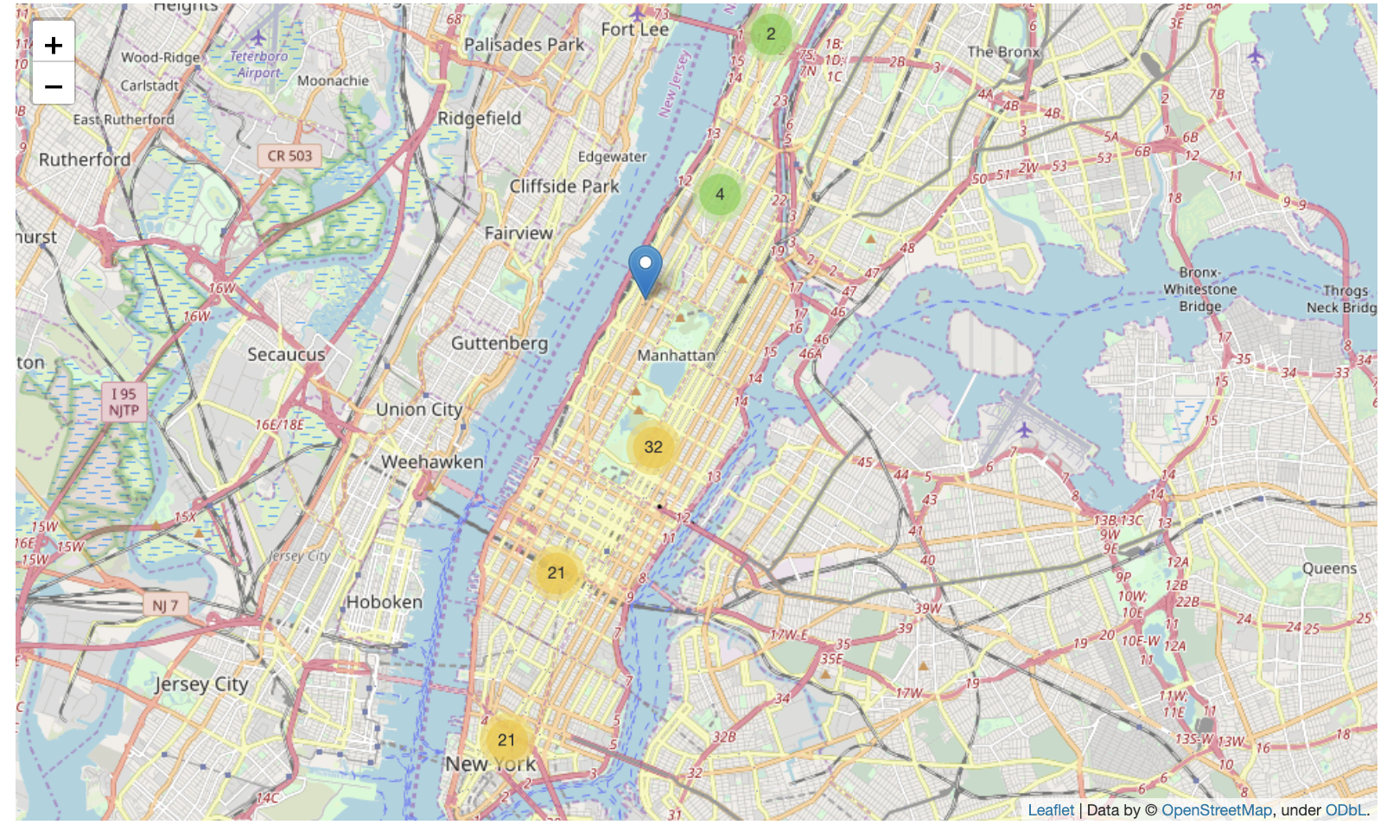
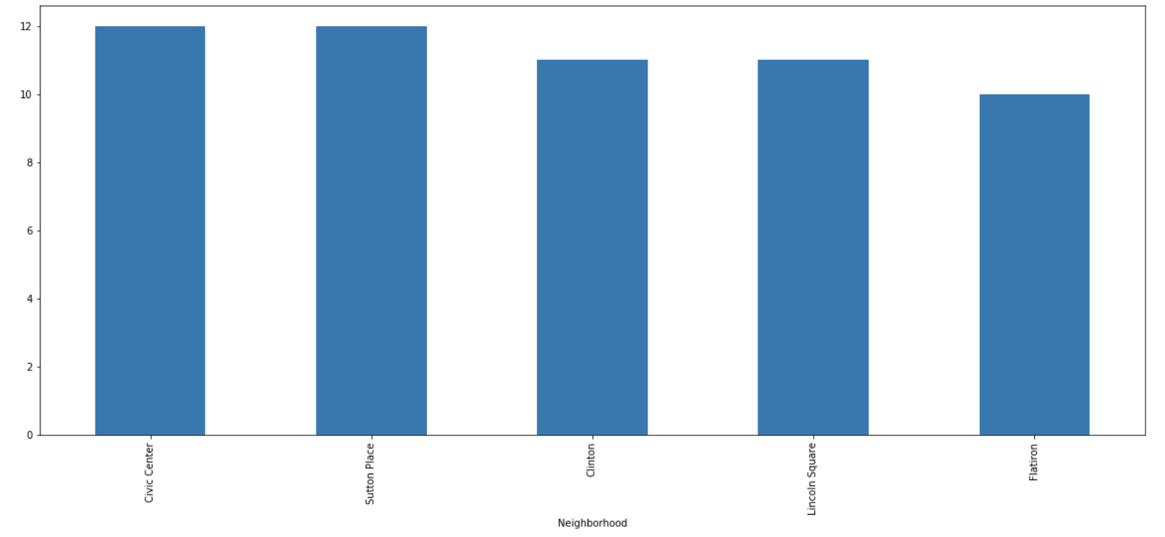
Neighborhoods by Customers
Top 5 Neighborhoods:-
Civic Center
Sutton Place
Clinton
Union Square
Flatiron

Slide 8
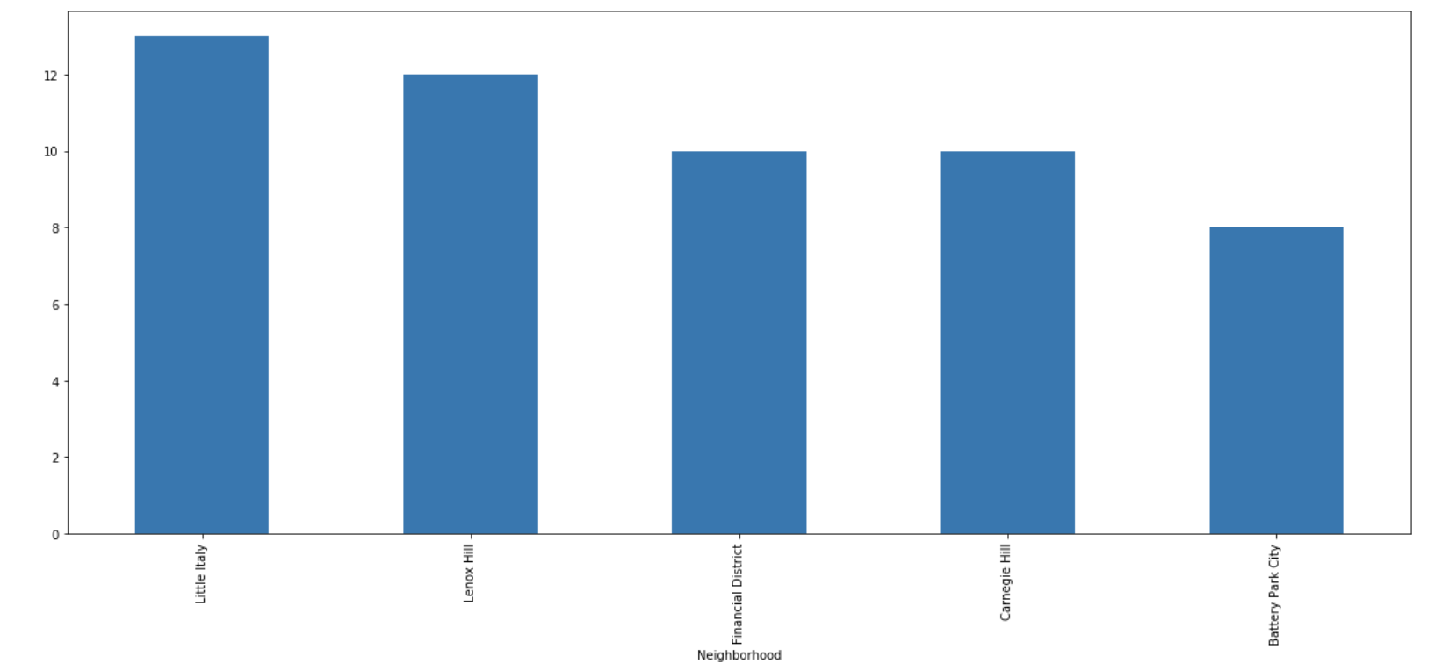
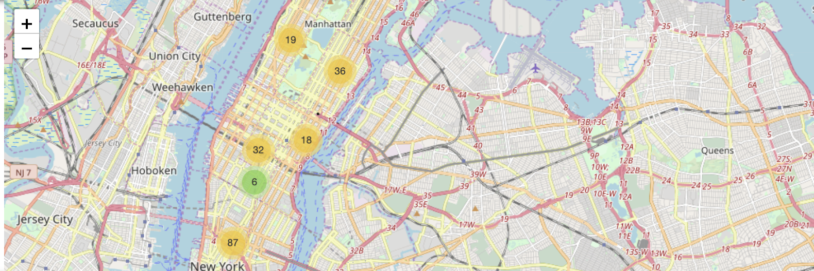
Neighborhoods by Competitors
Top 5 neighborhoods:-
Little Italy
Lenox Hill
Financial District
Carnegie Hill
Battery City Park

Slide 9
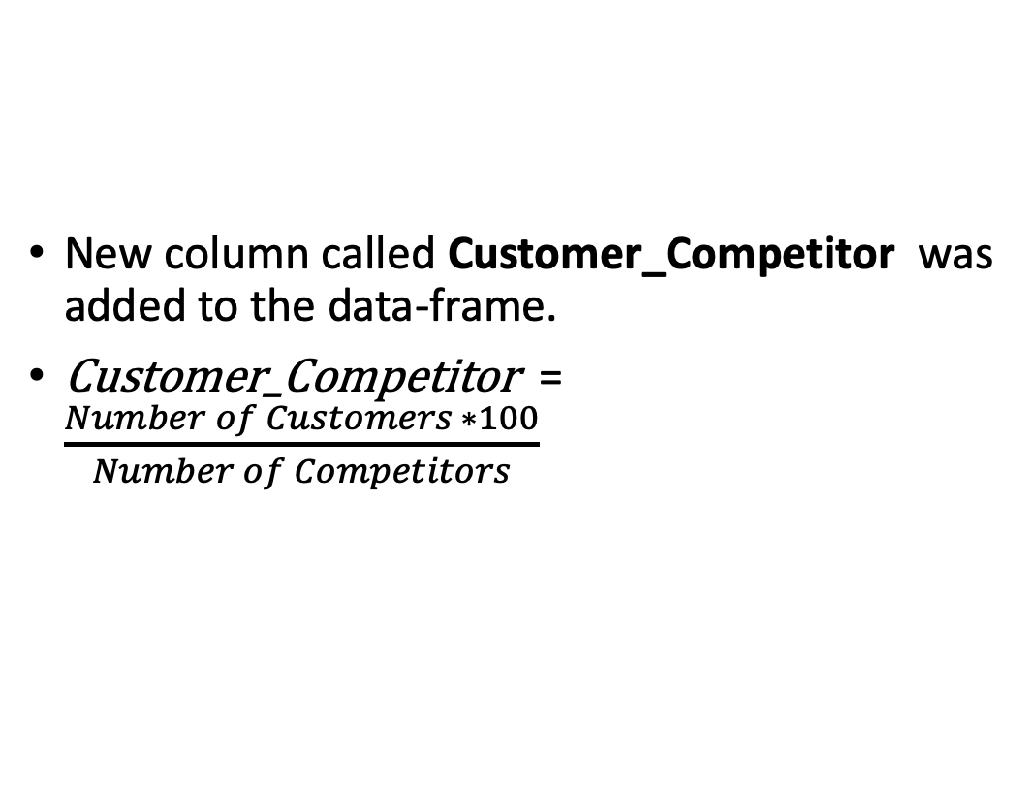
Customer_Competitor Ratio
New column called Customer_Competitor was added to the data-frame.
Customer_Competitor = $\frac{Number of Customers ∗100}{Number of Competitors}$

Slide 10
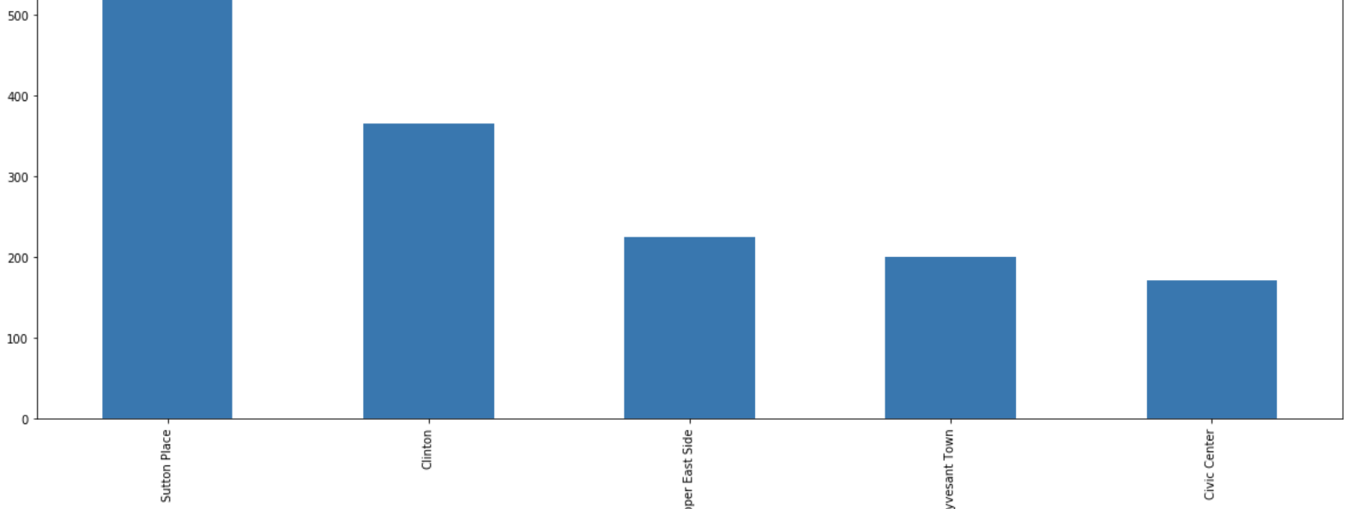
Neighborhoods by Customer_Competitor
Top 5 neighborhoods:-
Sutton Place
Clinton
Upper East Side
Stuyvesant Town
Civic Center

Slide 11
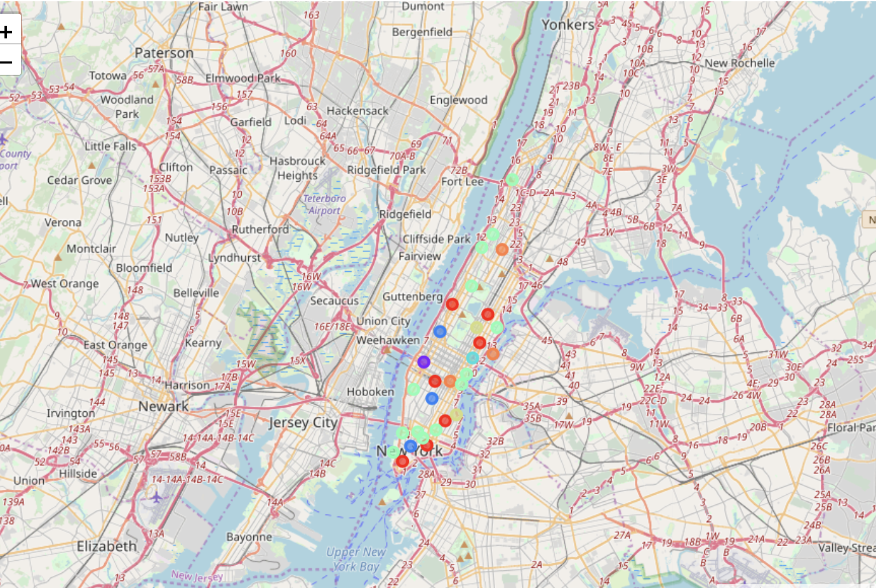
Clusters Map

Slide 12
Clusters Results
Cluster Label | Neighborhoods | Customer_Competitor Ratio
0 | Carnegie Hill Chinatown East Village Financial District Lenox Hill Midtown South Upper West Side | 60 - 75
1 | Clinton | 366
2 | Civic Center Flatiron Lincoln Square | 142 - 171
3 | Sutton Place | 600
4 | Chelsea Hamilton Heights Little Italy Manhattan Valley Manhattanville Noho Soho Tribeca Tudor City Turtle Bay Washington Heights YorkVille | 12 - 42
5 | Stuyvesant Town Upper East Side | 200 - 225
6 | Central Harlem Murray Hill Roosevelt Island | 85 – 100

Slide 13
Discussion
Neighborhoods that has a proportionate distribution of commercial enterprises, tourists’ spots, and residential areas are best suited to set up a coffee shop.
Neighborhoods that are at the geographical extremes of the city are not as well suited as they lack accessibility and public footfall.
Tourist and business neighborhoods are poorly suited as the number of existing coffee shops exceeds the number of customers.

Slide 14
Future Improvements
Incorporate factors like land prices, neighborhood rent, subway stops, number of residential building in the decision-making process.
Use techniques like Heat Maps for better visualization process.

